Slide 1
CS 205
Artificial Intelligence

Slide 2
First order logic
Entailment vs Inference
Soundness and Completeness
Propositions and Predicates
Functions and Skolem terms
Quantification: forall, exists
Let's take a look at Prof Eamonn's slides for a minute.

Slide 3
Automated Deduction
A program has common sense if it automatically deduces for itself a sufficiently wide class of immediate consequences of anything it is told and what it already knows. . . In order for a program to be capable of learning something it must first be capable of being told it.
—John McCarthy, 1959. One of its founding fathers, he coined the term "Artificial Intelligence."

Slide 4

Entailment vs Inference
Entailment (⊨) — what follows.
If we provide axioms, facts, and logical statements for a knowledge base, then we can expect that knowledge base to entail new facts that follow from what is known so far.
For example: can Susan lay eggs?
The only mammals that lay eggs are the echidna and platypus.
Only birds and mammals are warm blooded.
All birds have feathers.
Susan is warm blooded and has no feathers.
Inference (⊢) — how it follows.
Requires a process or procedure or algorithm, i.e., an inference engine, that computes and proves entailments.
If the inference engine is perfect (sound and complete) it computes all entailments correctly, and nothing else. The nothing else part is important. E.g., "a yes machine" is complete, but unsound.

Slide 5
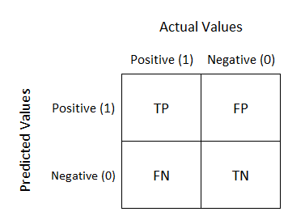
... an aside: confusion matrices
Soundness and completeness might remind you of a confusion matrix, for those that know about machine learning or data mining.
Actual Values are like the Oracle.
Predicted Values are like the Inference Engine.
Completeness is similar to recall (TP / TP + FN).
Soundness is similar to precision (TP/ TP + FP).
We will discuss this more when we cover machine learning.

Slide 6

Soundness and Completeness
Entailment (⊨)
Imagine a god-like Oracle, like Pythia at Delphi, who proclaims truths and is never wrong.
Inference (⊢)
Imagine Siri, Alexa or Google, which uses algorithms to answer questions, and may sometimes or often be wrong or unable to answer at all.
Soundness: how often does Alexa's answers agree with the Pythia's?
Completeness: how often can Alexa find an answer Pythia can?
Thus, in research, new inference algorithms should always measure their goodness by soundness and completeness. What else is important? (Efficiency?)

Slide 7
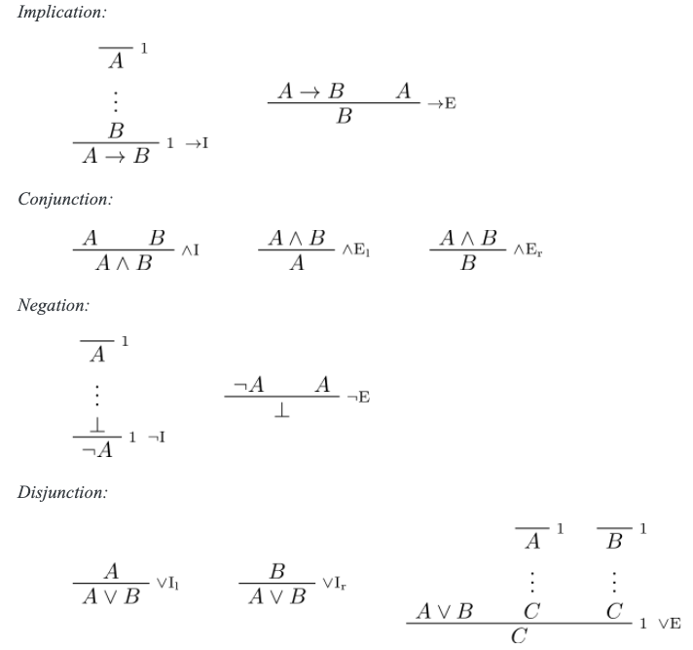
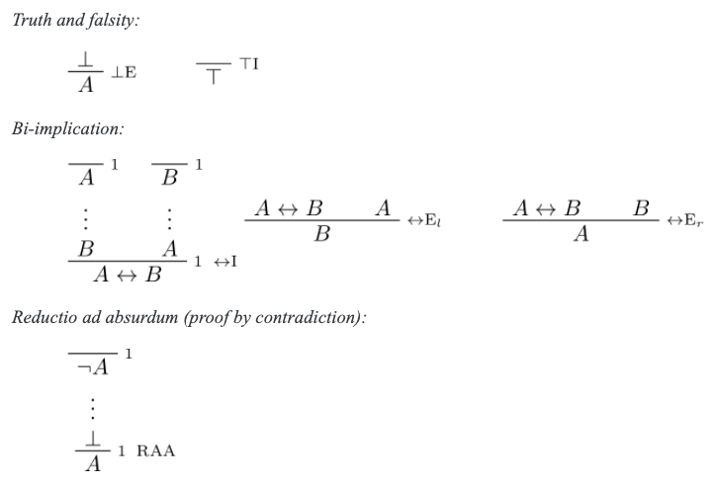
Natural Deduction
With the axioms of natural deduction, I can ask you: Is 𝐴∨¬𝐴 entailed? And the answer is yes, it is.
However, it's illogical to ask if it is inferred yet. Because we have not yet formally established the algorithm or system by which we make inferences yet.
We have played with making inferences, and convinced ourselves we can, but have not yet formalized how as a repeatable set of steps (an algorithm).
DOWNLOAD:
https://drive.google.com/file/d/1EXKODkS4ovUHDes7YfyrFOwTFIHcpr1g/view?usp=sharing

Slide 8
Natural Deduction
For example, Modus Ponens (→E) is quite nice.
I proclaim: my procedure is to only use modus ponens with a backward chaining approach (try to prove each goal, bottom up) to solve all logic homework problems. Will I get an A on my homework?
No. MP with BC is not complete, I would be unable to deduce 𝐴∨¬𝐴, which we already know is entailed.
DOWNLOAD:
https://drive.google.com/file/d/1EXKODkS4ovUHDes7YfyrFOwTFIHcpr1g/view?usp=sharing

Slide 9
Natural Deduction
... But what if the homework only has logic problems of the form (no ∨¬ symbols in sight): 𝐴₁∧𝐴₂∧...𝐴_{n} → 𝐶 Will I get an A on my homework (with MP+BC)?
Yes. This is called Horn Logic, and modus ponens with backward chaining (and forward chaining) is sound and complete for Horn Logic. So if we handle the conjunctions (which is trivial), I will get an A.
Many everyday problems conform to Horn Logic. Humans are pretty good at doing Horn Logic. I often call it "following your nose" type of reasoning. Easy sudoku puzzles are Horn Logic like.
DOWNLOAD:
https://drive.google.com/file/d/1EXKODkS4ovUHDes7YfyrFOwTFIHcpr1g/view?usp=sharing

Slide 10
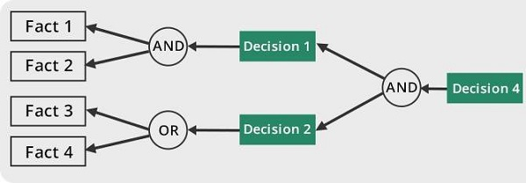


Backward Chaining
Goal-driven procedure ("algorithm"):
choose goal from set of goals
if goal is a fact, stop
otherwise identify and add new goals
repeat until no goals are left
Simple, efficient, no wasted efforts.
Only what is needed is what is explored.
Sounds good: Is backward chaining the best option?
Often, it is the go-to approach. A nice balance between space and time.
Tradeoff: every goal starts anew, less gains over time.
Source: https://www.tutorialspoint.com/artificial_intelligence/artificial_intelligence_quick_guide.htm

Slide 11
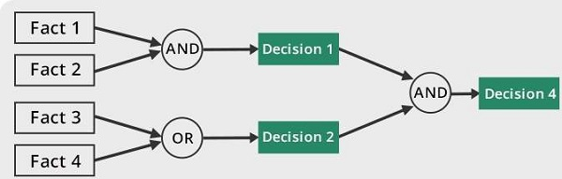
Forward Chaining
Data-driven procedure ("algorithm"):
choose fact from all facts
generate new facts
if goal reached, stop
Simple, not efficient, potentially tons of wasted efforts.
Potential to explore wildly wrong directions.
Why bother: Is forward chaining bad? Not always.
Advantage: if newly generated facts are kept, over time, magic happens!
Less wild exploration over time.
Faster solutions over time.
Tradeoff: space to store all of it.
dum dee dum...
Source: https://www.tutorialspoint.com/artificial_intelligence/artificial_intelligence_quick_guide.htm

Slide 12
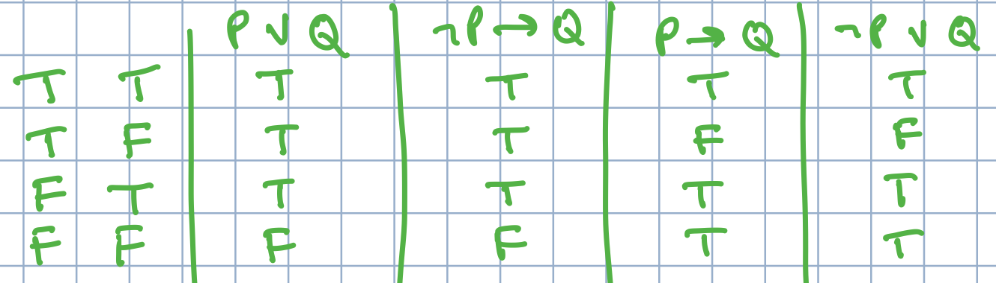
Reasoning by Cases
Disjunctions (and negations) take us beyond Horn Logic.
How are negations related to disjunctions (vis a vis Horn Logic)?
𝐴∨𝐵 is equivalent to ¬𝐴→𝐵 𝐴→𝐵 is equivalent to ¬𝐴∨𝐵
Hard sudoku puzzles cannot be solved by Horn Logic style reasoning. You have to do case-based reasoning. Humans (and computers) are less good at this. It is HARD, in the formal sense, P/NP, i.e., exponential poly-time.

Slide 13
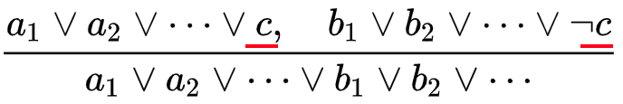
Resolution
In natural deduction, we could add another axiom (provable from existing ones) and call it resolution:
I like to think of it as annihilation! Like matter and anti-matter colliding to annihilate one another.
Can you? Prove that resolution is valid in natural deduction.You'll at least need OR-elimination, and a few others....

Slide 14
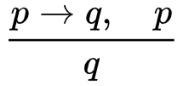
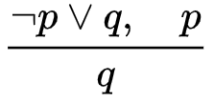
Resolution
Resolution should feel familiar, because modus ponens is a special case.
Imagine: We can convert these! We can get rid of all implication symbols.

Slide 15
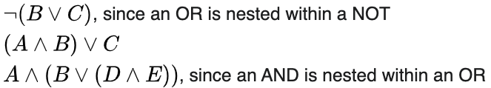
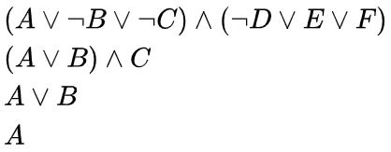

Resolution as a procedure
Resolution procedure ("algorithm"):
first convert to conjunctive normal form (aka, product of sums)
repeatedly apply resolution until goal is reached
Sounds easier than it is in reality, including the first thing (expensive!).
To reach goals efficiently, backward chaining, forward chaining and resolution require good Search algorithms (Act II of this course).
No ... not CNF! Anything with implication symbols but also...
Yes ... CNF!
Source: https://en.wikipedia.org/wiki/Conjunctive_normal_form

Slide 16
Pause for Q&A
This is where you get to ask me for help on your homework problems ... so don't be shy.

Slide 17

Predicates and Functions
Propositions are statements, represented as symbols (A, B, P, Q, R, ...)
We also have other syntax:
logical connectives (implication, conjunction, negation etc.)
parentheses for grouping
and constants (true or false, top or bottom)
NEW A function is a statement that returns terms.
e.g., MotherOf( FatherOf(PAEA) ) returns ODETTE.
NEW A predicate is a function that only returns true or false.
e.g., isWarHero(ODETTE) returns TRUE.
So far, everything presented has been propositional.
True! My grandma was a Chevalier and Officier (2nd of 3 levels) of the French Legion of Honor. It's sort of like the US Medal of Honor.
Odette LePendu (1924-2020) fought Nazis in World War II when she was 14 years old and was captured and tortured, but was lucky enough to be released. My hero, miss you grandma!

Slide 18
Semantics (vs Syntax)
Normally, you would think of semantics simply as truth tables and simple interpretations of symbols, e.g., "P means it is raining. Q means I get wet." So P→Q means,"If it's raining I'll get wet." And that's always true unless it rains and I don't get wet.
But you might imagine a universe where P and Q meant something else, and yet the same exact truth assignments ALSO made sense! (And some P's and Q's where they don't.)
Syntax — how to say it.
Semantics — what it means.
Semantics come from two things:
truth assignment
interpretations
Formally speaking, semantics are interpretations that formally map logical models onto valid worlds. There could be many possible worlds! Take a look the thesis of Dejing Dou, my PhD Advisor, page 43 (cf p34).`

Slide 19
Quantifiers
Universal (∀) — for all
Existential (∃) — exists
∀x isDog(x) → goesToHeaven(x) For all x, isDog(x) implies goesToHeaven(x).
All dogs go to heaven.
∃x,y isDog(x) ∧ isCat(y) ∧ loves(x,y) Exists x,y, isDog(x) and isCat(y) and loves(x,y).
Some dogs love (some) cats.

Slide 20
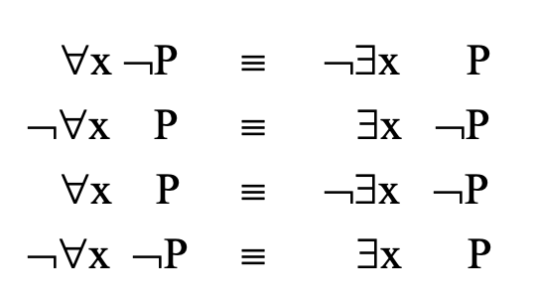
Quantifiers
Generalizing De Morgan's Laws gives us these transformations:

Slide 21
Quantifiers
Distributivity and commutativity rules also allow us to "move" quantifiers around in complex logical statements. (How is beyond our scope.) ∀x isDog(x) → ∃y master(y,x) ∧ loves(x,y) All dogs have a master who they love.
We prefer (and expect on exams) that all quantifiers appear at the beginning of any statement.

Slide 22
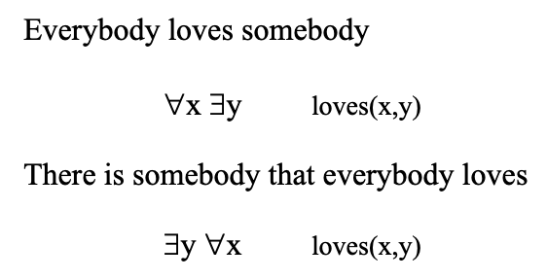
Quantifers
Order matters!
Let's take a look at Prof Eamonn's slides for a minute again.

